Slide 1
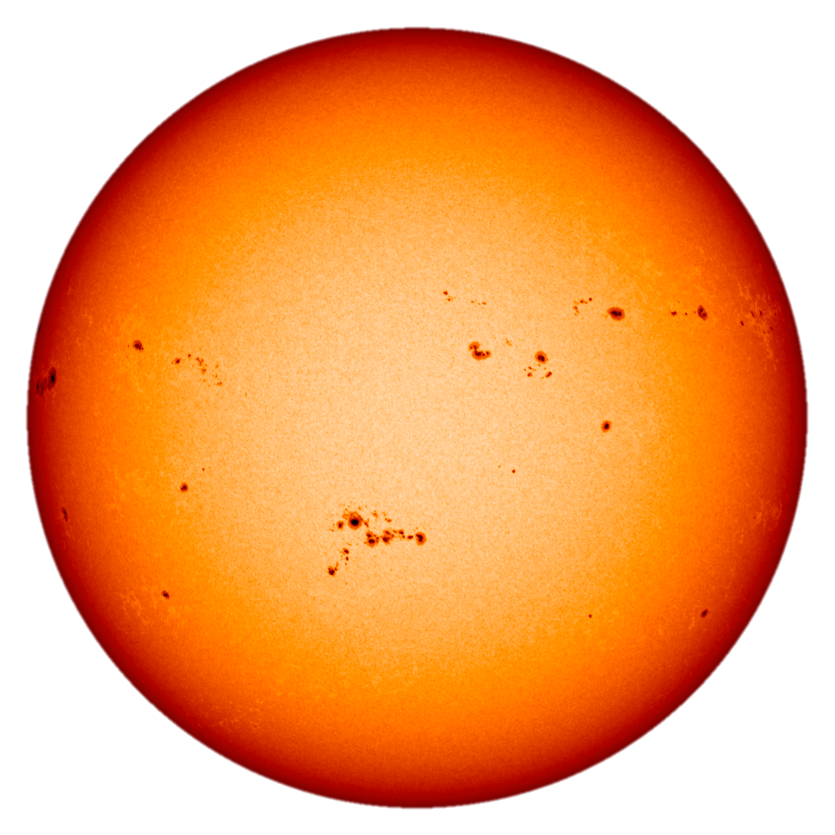
Listening for Exoplanet Transits
Ben Rackham & Aiden Gibbs
University of Arizona, Project EDEN

Slide 2
About me (Ben):
From Salt Lake City, UT
A postdoc at the University of Arizona
Finished my PhD last year of the U of A
majored in Astronomy & Astrophysics
minored in Astrobiology
my thesis work included studies on the atmospheres of transiting exoplanets and how starspots complicate those measurements
Life goal: Be part of the team that finds life on an exoplanet
Also starting work on Project EDEN, a survey to detect new transiting exoplanets!

Slide 3
Top-level questions:
What is a transiting exoplanet?
How can we measure its size?
How can we estimate its temperature?
Where can we look for planets like Earth?

Slide 4
What is a transiting exoplanet?

Slide 5
What is a transiting exoplanet?
An exoplanet is a planet that orbits a star other than the Sun.
A transiting exoplanet is one that passes in front of its star from our point of view.
Through transits we can learn about the planet’s:
mass, radius, density
orbital period, temperature
atmospheric composition
including (in the near future) signs of life

Slide 6
How do we measure the size of an exoplanet?

Slide 7
Think-pair-share:
For a given star, a transit of a larger planet will block:
A) more light than a smaller planet
B) less light than a smaller planet
C) the same amount of light as a smaller planet

Slide 8


Slide 10
Think-pair-share:
For a given planet, its transit will be deeper in a system with a:
A) smaller star
B) larger star
C) the size of the star doesn’t affect the transit depth

Slide 12
Is this planet bigger or smaller than Earth?
Notes:
Mars: 0.532 R_earth

Slide 13
Is this planet bigger or smaller than Earth?
Notes:
TRAPPIST-1g: 1.15 R_earth

Slide 14
Real data is noisy

Slide 15
How can we estimate its temperature?

Slide 16
Think-pair-share:
All other things being equal, planets that are closer to their stars are:
A) hotter than planets that are farther out
B) cooler than planets that are farther out
C) the orbital distance of a planet doesn’t affect its temperature

Slide 17
Think-pair-share:
Which of the observable features of a transit light curve tell us about the planet’s temperature?
A) the transit depth
B) the transit duration
C) the frequency of transits
D) the shape of the transit profile (squareness vs. roundness)

Slide 18
The frequency of transits tells us the orbital period!

Slide 19
Two planets

Slide 20
Which of these planets is hottest?

Slide 21
Where can we look for planets like Earth?

Slide 22
Think-pair-share:
It’s easiest to find temperate Earth-sized planets around stars that are:
A) the same size as the Sun
B) smaller than the Sun
C) larger than the Sun

Slide 23
The TRAPPIST-1 System

Slide 24


Slide 25
Activity: Characterizing the TRAPPIST-1 System
Using sonified light curves for each of the seven planets, we will determine their sizes and temperatures.
Part 1: Planetary Radii
Part 2: Planetary Temperatures
Part 3: The Search for Life in the TRAPPIST-1 System

Slide 26
Part 1: Planetary Radii
Listen to the “single-transit” light curves of the TRAPPIST-1 planets and rank them from smallest to largest.
The provided Excel workbook includes a ranked list of the measured transit depths. Use it to assign the right transit depth to each planet and calculate its radius in units of Earth radii.

Slide 27
Part 2: Planetary Temperatures
Listen to the “20-day” light curves of the TRAPPIST-1 planets. Each second in these light curves represents one day of observations. With this information, estimate the orbital periods of each of the planets.
The provided Excel workbook includes a ranked list of the measured orbital periods. Use it to assign the precise orbital period to each planet and calculate its temperature in Kelvin.

Slide 28
Part 3: The Search for Life in the TRAPPIST-1 System
As a group, discuss which of these planets is the most like Earth. Are any of them too hot for life? Too cold for life? For reference, the equilibrium temperature of Earth is 255 K.
What other information about these planets would you like to know in order to prioritize follow-up observations?
As a group, assign a spokesperson to share with the whole class your answers to the previous questions and your reasoning.

Slide 29
Summary
Transits give us an amazing opportunity to study planets that orbit other stars.
The depth of the transit tells us the planet’s size (composition).
The timing tells us its orbital period (temperature).
Together, these two pieces of information go a long way towards characterizing an exoplanet!
It’s easier to detect smaller, cooler planets if we look for them around smaller (cooler) stars

